Slide 1
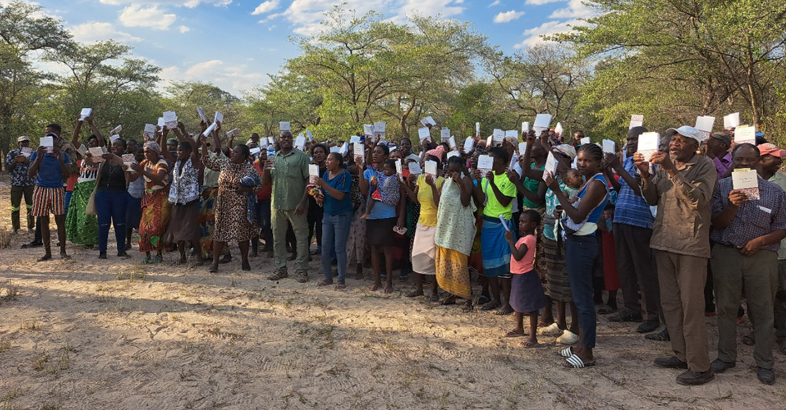
Community Acceptance

Slide 2
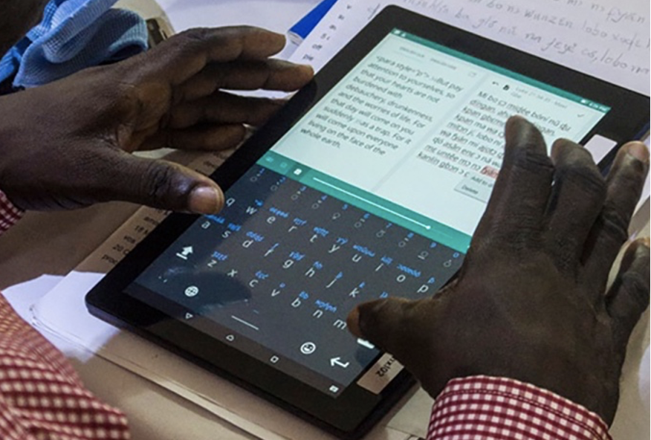
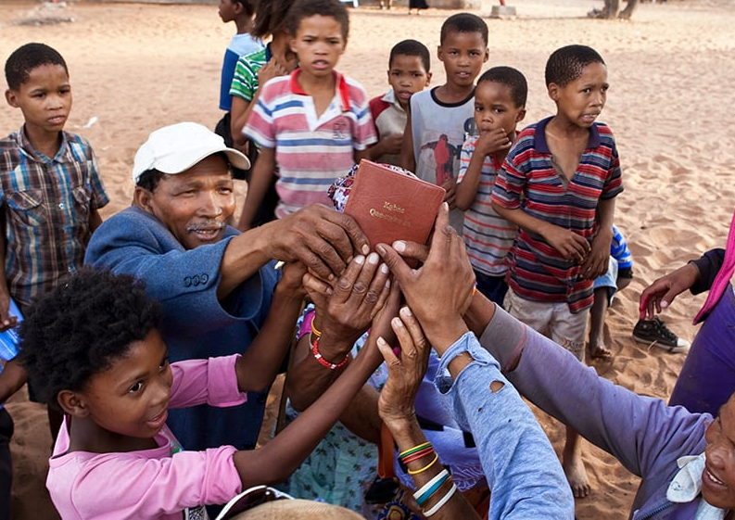
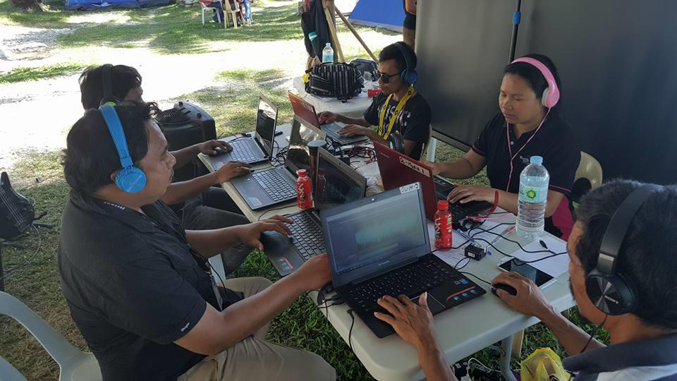

What expectations does your community have?
1 Corinthians 9:22

Slide 3
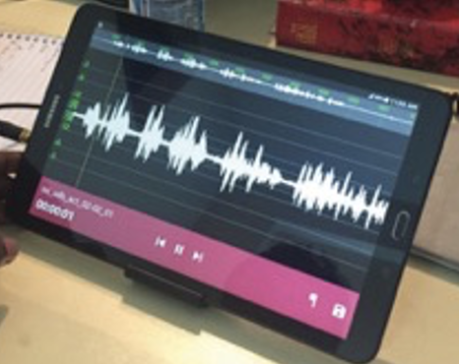
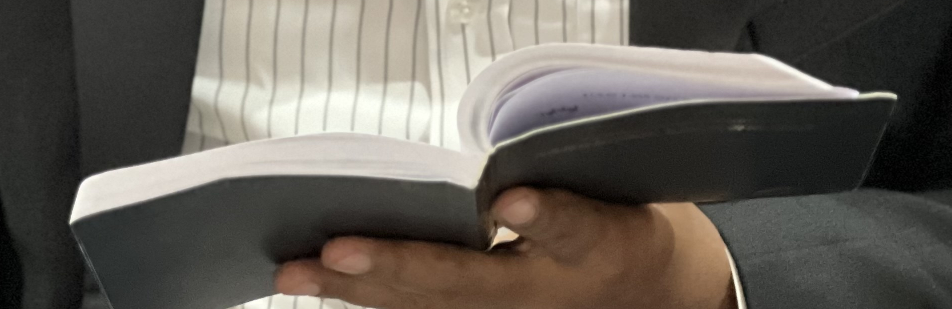
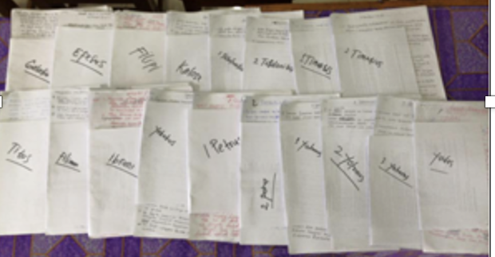

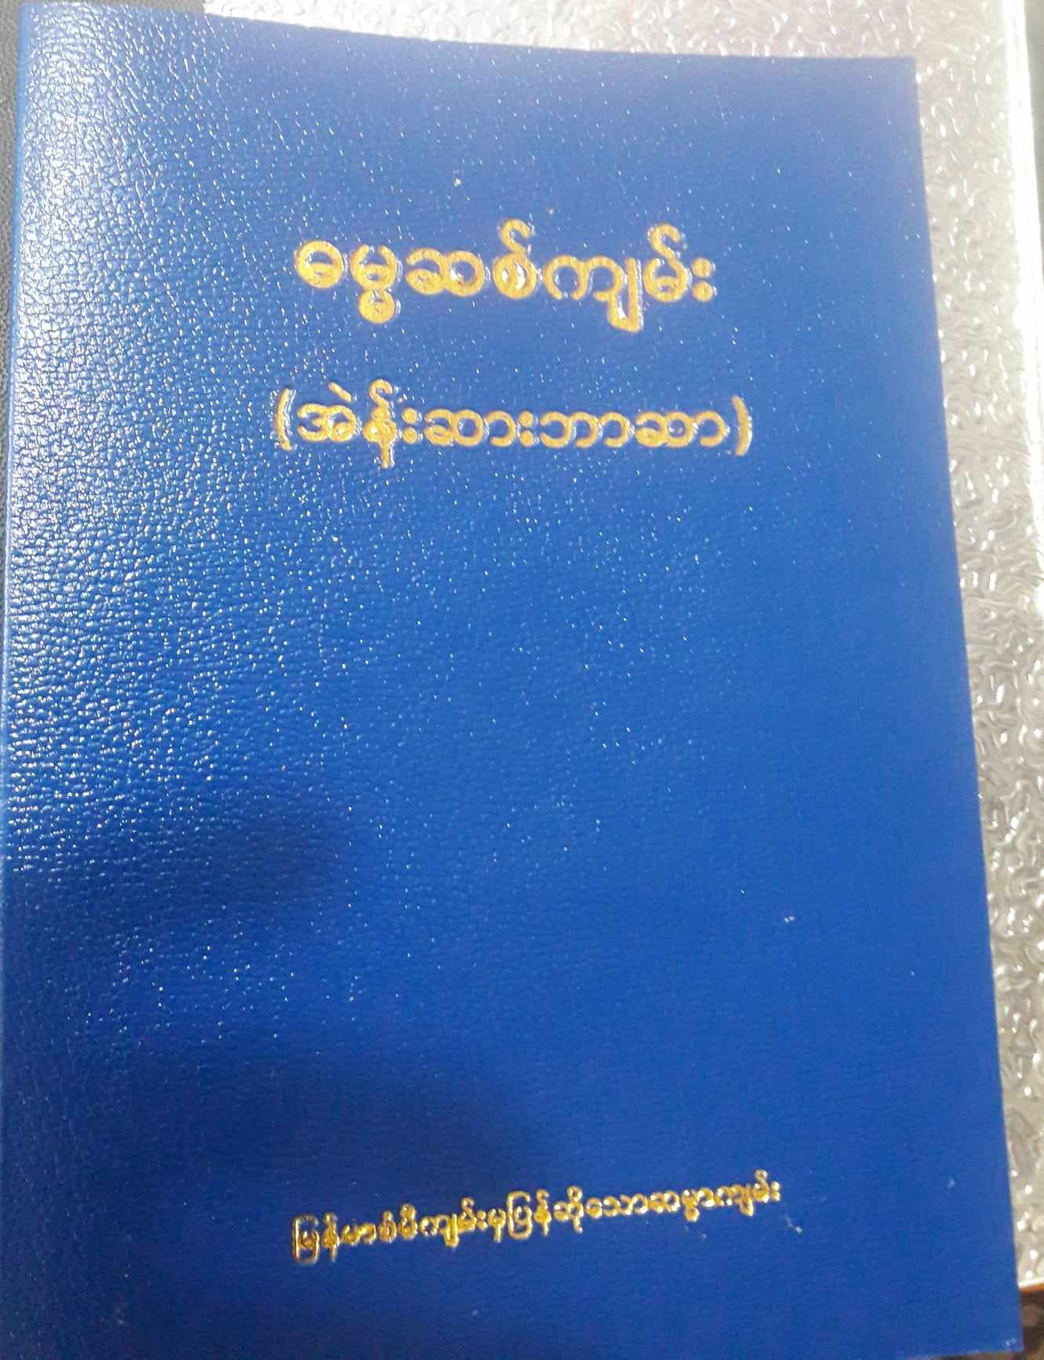
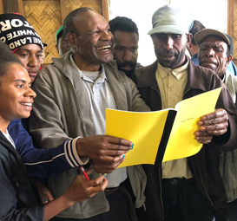
Challenges?

Slide 4
?
Suggestions?
Luke 14:28⎼30

Slide 5
?
What characteristics are expected?
What would be accepted?
Format
Printing & paper
Cover
Notes:
01/19/2024

Slide 6


